Slide 1
Implementation Object Linking and Embedding for Process Control Unified Architecture Specification With Smart Card Technology for secure application and service
The future standard for communication and information modeling in automation
Yuankui Wang

Slide 2
Agenda
System Design
Implementation and Test
Security Concerns

Slide 3
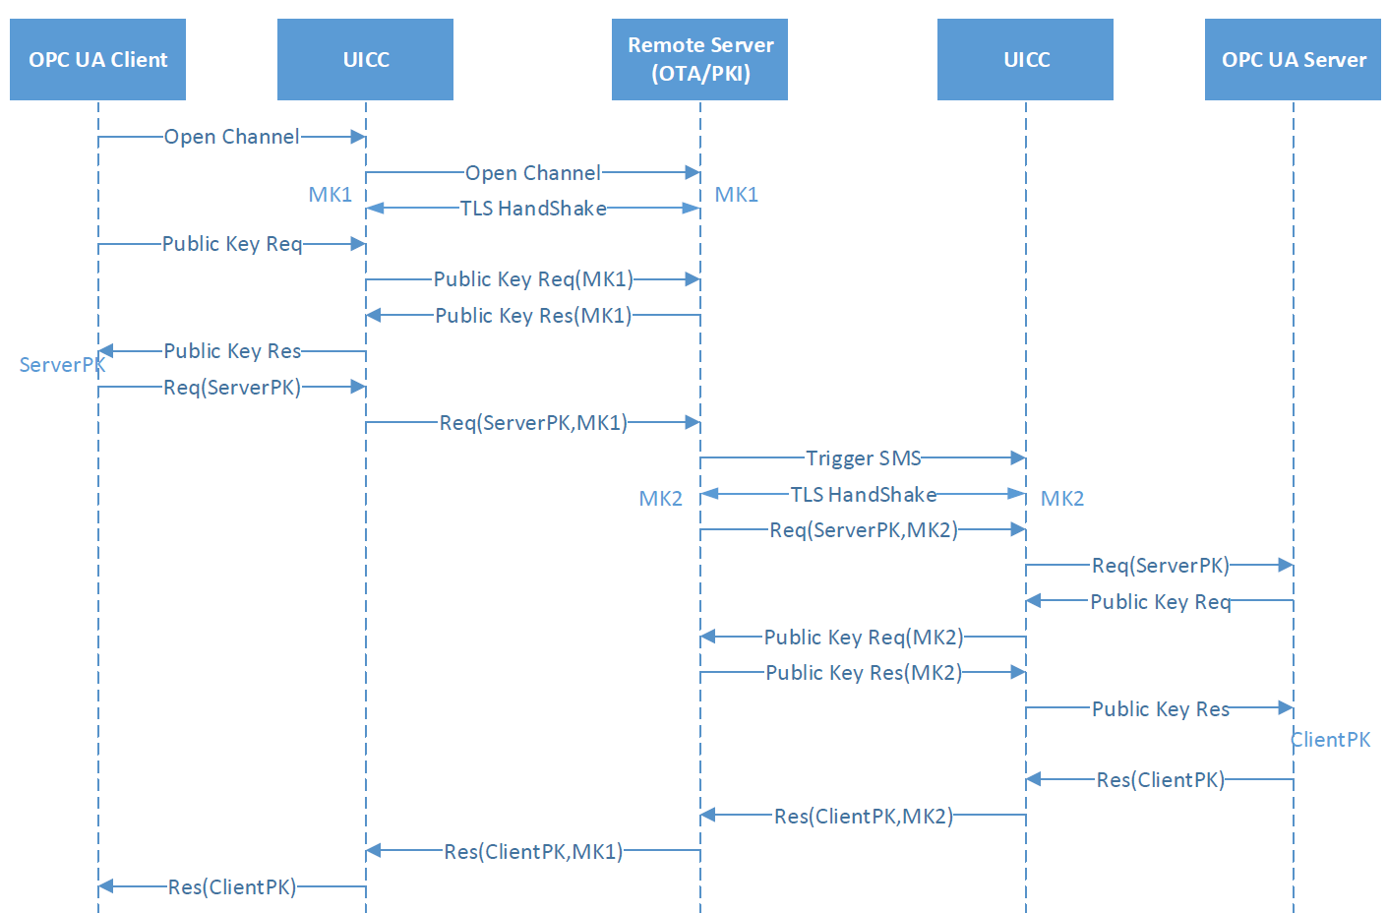
System Design: Overview

Slide 4
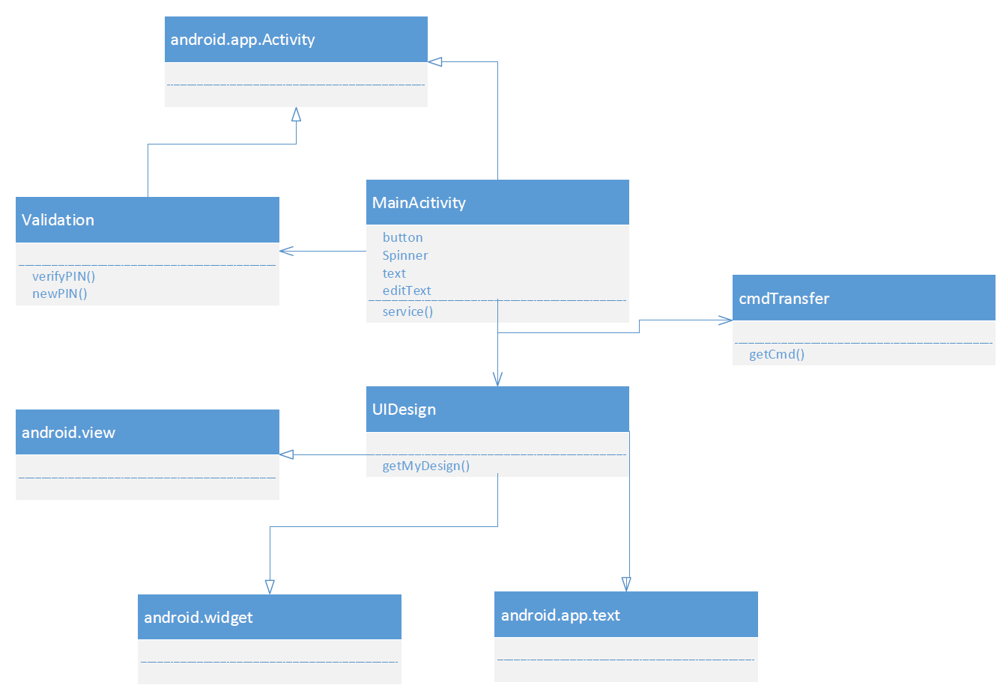
System Design: Android UI Class

Slide 5
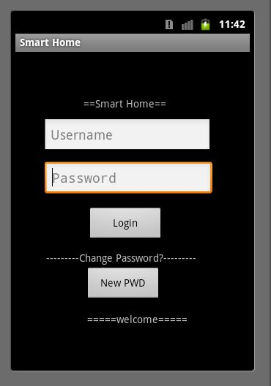
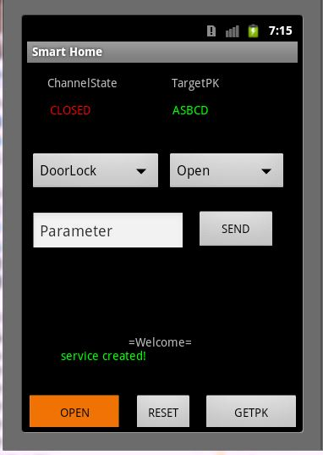
System Design: Android UI

Slide 6
System Design: Android UI
Login
Retry count = 3
Username/pwd stored on smart card
New Pwd
Retry counter >3
Lock card
Email notification

Slide 7
System Design: Android UI
DoorLock
Open
GetRecord
GrantAccess
Sensor:
GetValue
SetSubscrition
GetRecord
CafeMaker
AddWater
AddCafe
MakeCafe

Slide 8
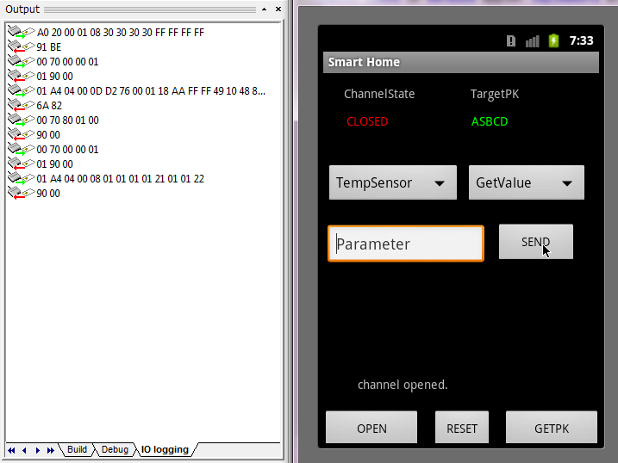
Test: VerfiyPIN and Select Appelt

Slide 9
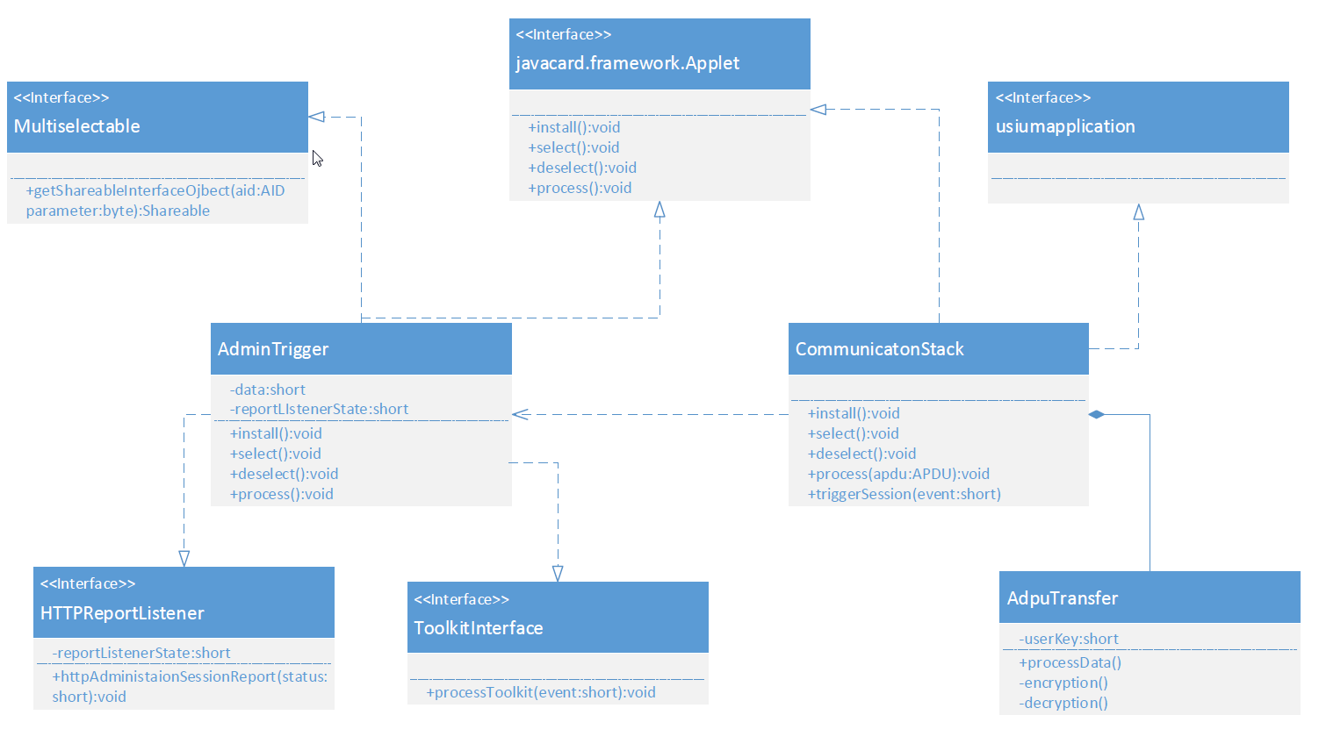
System Design: Applet Class
CommunicationStack:
AdminTrigger
ApduTransfer

Slide 10
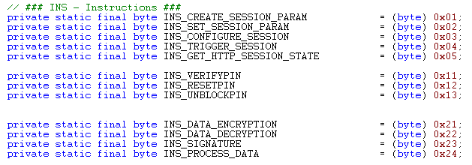

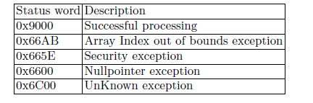
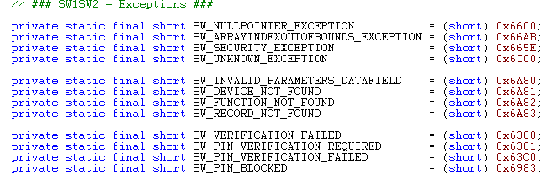
System Design: CAD-SD Interface

Slide 11
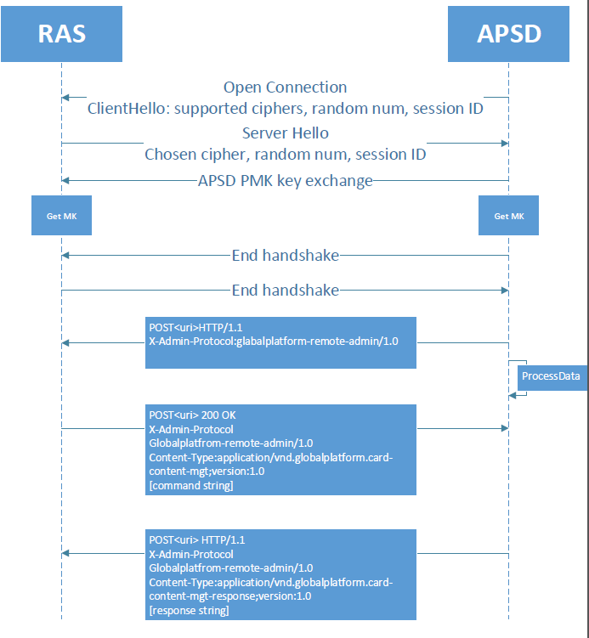
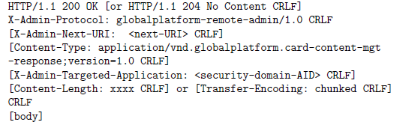
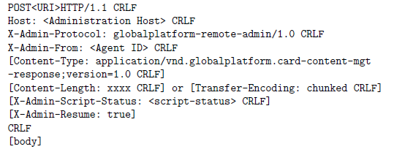
System Design: Communication Flow
SMS Trigger

Slide 12
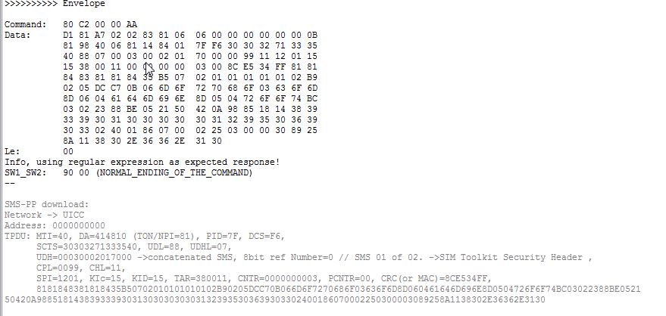
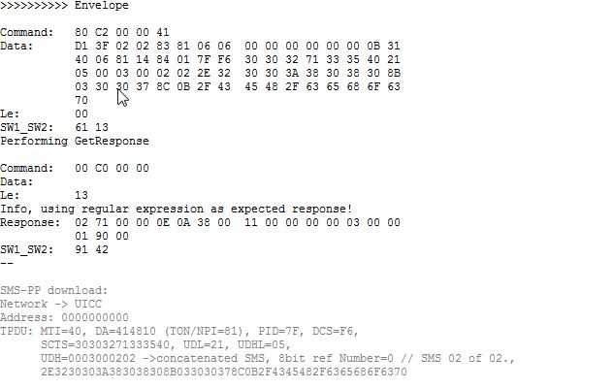
Test: Successfully Receive Trigger SMS

Slide 13
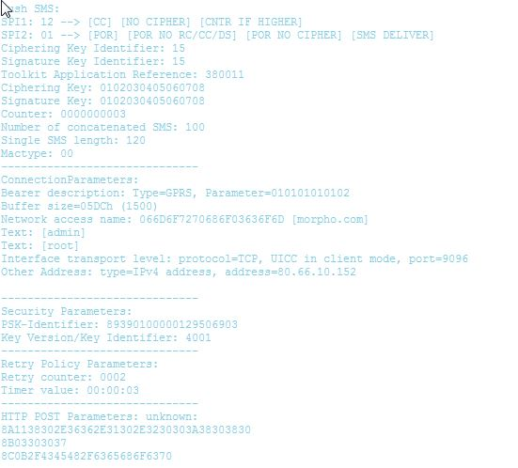
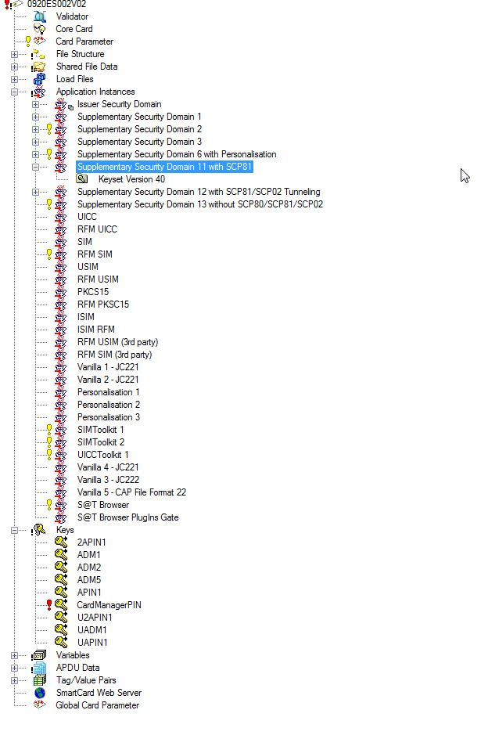
Test: Successfully Receive Trigger SMS

Slide 14
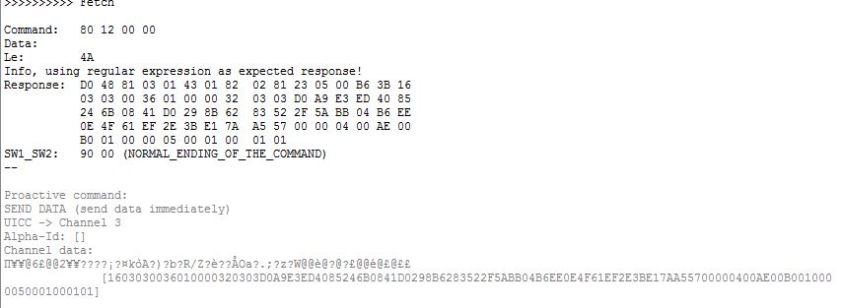
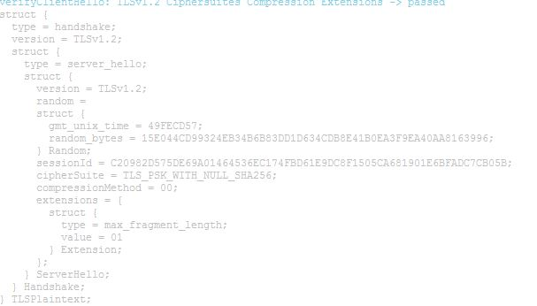
Test: Client Hallo and Server Hallo

Slide 15
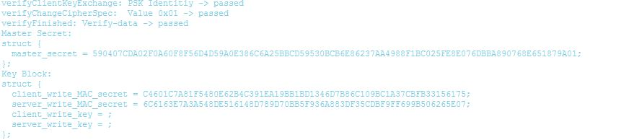
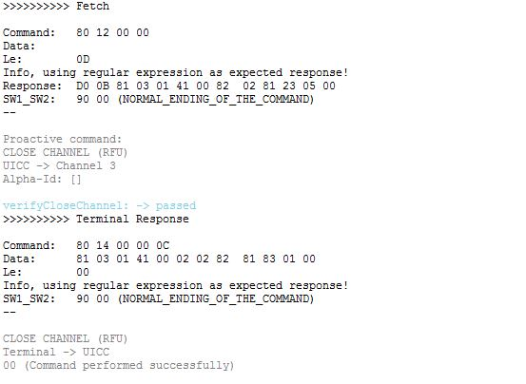
Test: Successfully Generate MK and Close Channel

Slide 16
Security Concerns
Overall System Design Security Concerns:
Authorization, Confidentiality, integrity and etc.
Traceability
Appropriate Timeouts
Rate Limiting and Flow Control
Random Number Generation
CAD-Applet Security:
Authentication: SE Access Control from GlobalPlatform
Secure Messaging: OpenMobile API
Appelt-Appelt Security:
RAM/RFM standard from GlobalPlatform
TLS1.2 based communication session
PKI

Slide 17
Thank you! Question?

